Slide 1
Decision Tree and KNN
Risman Adnan Mattotorang, Ph.D.

Slide 2
Last Week Material
Linear Basis Function Model for Classification
Linear Discriminant Model for Regression

Slide 3
What We Will Learn
Decision Tree Model
Main Concepts
Hypothesis Set
Learning Algorithm
K-Nearest Neighbor Model
Main Concepts
Hypothesis Set
Learning Algorithm

Slide 4
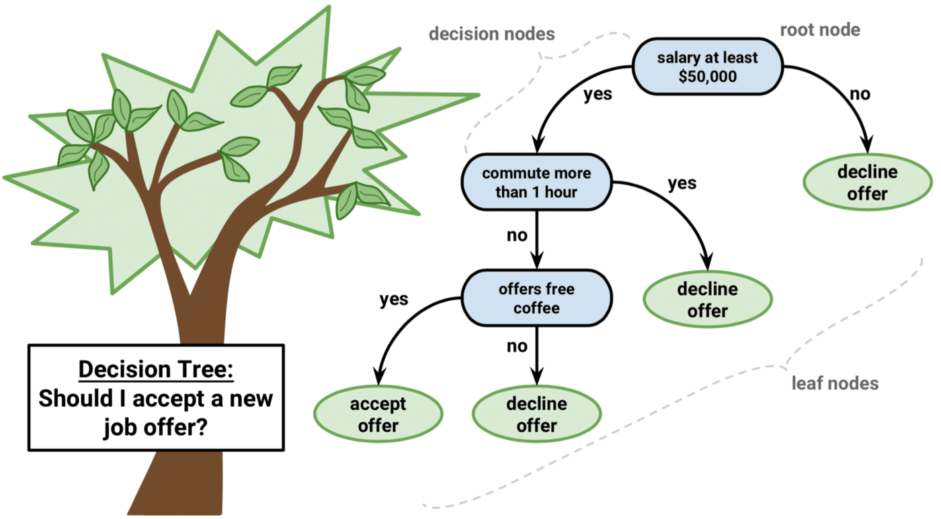
Decision Tree
Intuitive appeal for users
Presentation Forms
“if, then” statements (decision rules)
graphically - decision trees
Works like a flow chart
Looks like an upside down tree
Nodes represent test or decision
Lines or branches - represent outcome of a test
Circles - terminal (leaf) nodes
Top or starting node- root node
Internal nodes - rectangles

Slide 5
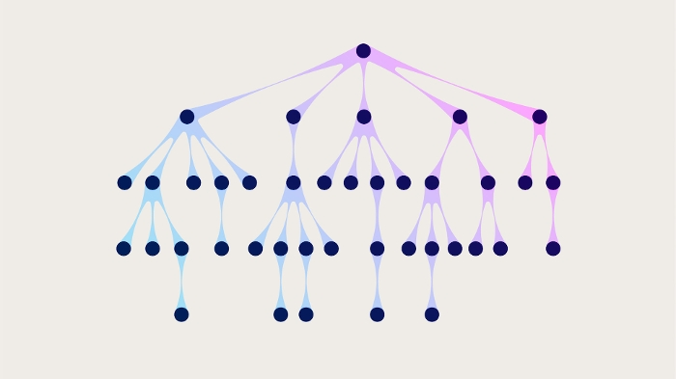
Example of Decision Tree
Bank - loan application
Classify application
approved class
denied class
Criteria - Target Class approved if 3 binary attributes have certain value:
Borrower has good credit history (credit rating in excess of some threshold)
Loan amount less than some percentage of collateral value (e.g., 80% home value)
Borrower has income to make payments on loan
Possible scenarios = 3² = 8
If the parameters for splitting the nodes can be adjusted, the number of scenarios grows exponentially.

Slide 6

How It Works
Decision rules - partition sample of data
Terminal node (leaf) indicates the class assignment
Tree partitions samples into mutually exclusive groups
One group for each terminal node
All paths
start at the root node
end at a leaf
Each path represents a decision rule
joining (AND) of all the tests along that path
separate paths that result in the same class are disjunctions (ORs)
All paths - mutually exclusive
for any one case - only one path will be followed
false decisions on the left branch
true decisions on the right branch

Slide 7
Disjunctive Normal Form
Non-terminal node - model identifies an attribute to be tested
test splits attribute into mutually exclusive disjoint sets
splitting continues until a node - one class (terminal node or leaf)
Structure - disjunctive normal form
limits form of a rule to conjunctions (adding) of terms
allows disjunction (or-ing) over a set of rules

Slide 8
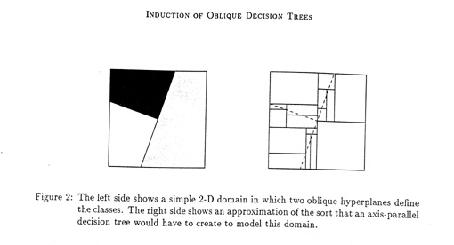
Geometry
Disjunctive normal form
Fits shapes of decision boundaries between classes
Classes formed by lines parallel to axes
Result - rectangular shaped class regions

Slide 9
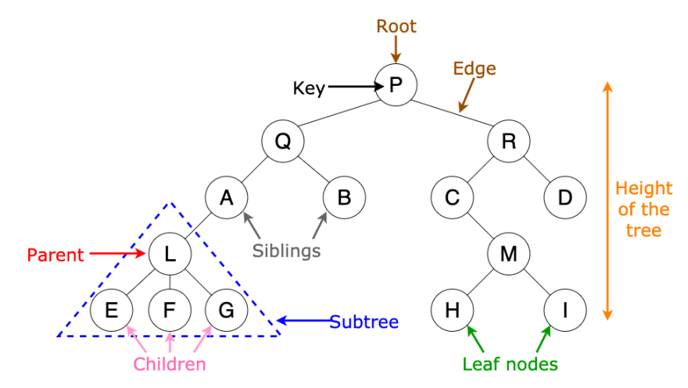
Binary Trees
Characteristics
two branches leave each non-terminal node
those two branches cover outcomes of the test
exactly one branch enters each non-root node
there are n terminal nodes
there are n-1 non-terminal nodes

Slide 10
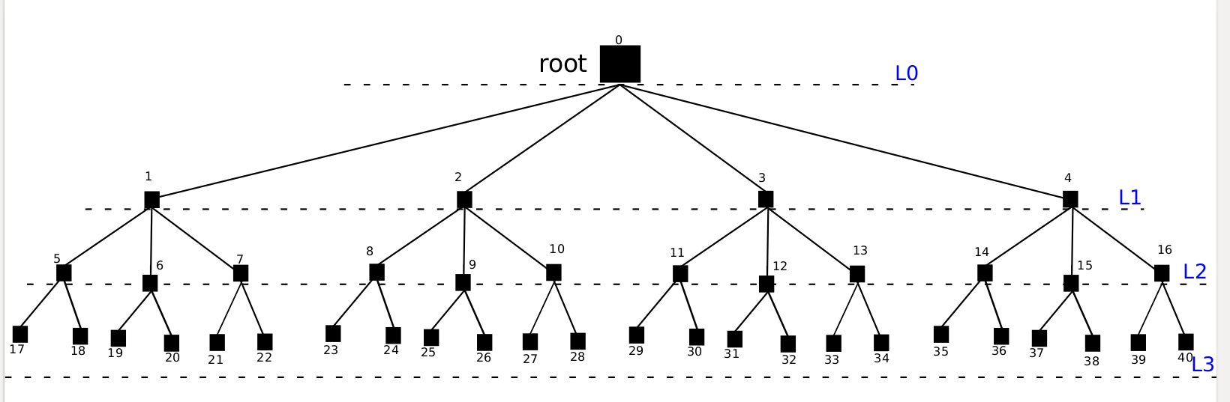
Non-Binary Trees
Characteristics
two or more branches leave each non-terminal node
those branches cover outcomes of the test
exactly one branch enters each non-root node
there are n terminal nodes
there are n-1 non-terminal nodes

Slide 11
The Goal
Dual goal - Develop tree that
is small
classifies and predicts class with accuracy
Small size
a smaller tree more easily understood
smaller tree less susceptible to overfitting
large tree less information regarding classifying and predicting cases

Slide 12
Rule Induction
Process of building the decision tree or ascertaining the decision rules
tree induction
rule induction
induction
Decision tree algorithms
induce decision trees recursively
from the root (top) down - greedy approach
established basic algorithms

Slide 13
Discrete and Continuous Attributes
Continuous variables attributes - problems for decision trees
increase computational complexity of the task
promote prediction inaccuracy
lead to overfitting of data
Convert continuous variables into discrete intervals
“greater than or equal to” and “less than”
optimal solution for conversion
difficult to determine discrete intervals ideal
size
number

Slide 14
Making The Split
Models induce a tree by recursively selecting and subdividing attributes
random selection - noisy variables
inefficient production of inaccurate trees
Efficient models
examine each variable
determine which will improve accuracy of entire tree
problem - this approach decides best split without considering subsequent splits

Slide 15

Evaluating the Split
Measures of impurity or its inverse, goodness reduce impurity or degree of randomness at each node popular measures include:
Entropy Function
Gini Index
Twoing Rule

Slide 16
Overfitting
Error rate in predicting the correct class for new cases
overfitting of test data
very low apparent error rate
high actual error rate

Slide 17
Optimal Size
Certain minimal size smaller tree
higher apparent error rate
lower actual error rate
Goal
identify threshold
minimize actual error rate
achieve greatest predictive accuracy

Slide 18
Ending The Tree Growth
Grow the tree until
additional splitting produces no significant information gain
statistical test - a chi-squared test
problem - trees that are too small
only compares one split with the next descending split

Slide 19
Pruning
Grow large tree
reduce its size by eliminating or pruning weak branches step by step
continue until minimum true error rate
Pruning Methods
reduced-error pruning
divides samples into test set and training set
training set is used to produce the fully expanded tree
tree is then tested using the test set
weak branches are pruned
stop when no more improvement

Slide 20
Pruning
Resampling
5 - fold cross-validation
80% cases used for training; remainder for testing
Weakest-link or cost-complexity pruning
trim weakest link ( produces the smallest increase in the apparent error rate)
method can be combined with resampling

Slide 21
Advanced Decision Trees
Multivariate or Oblique Trees
CART-LC - CART with Linear Combinations
LMDT - Linear Machine Decision Trees
SADT - Simulated Annealing of Decision Trees
OC1 - Oblique Classifier 1

Slide 22
Evaluating Decision Trees
Method’s Appropriateness
Data set or type
Criteria
accuracy - predict class label for new data
scalability
performs model generation and prediction functions
large data sets
satisfactory speed
robustness
perform well despite noisy or missing data
intuitive appeal
results easily understood
promotes decision making

Slide 23
Decision Tree Limitations
No backtracking
local optimal solution not global optimal solution
lookahead features may give us better trees
Rectangular-shaped geometric regions
in two-dimensional space
regions bounded by lines parallel to the x- and y- axes
some linear relationships not parallel to the axes

Slide 24
Conclusions
Utility
analyze classified data
produce
accurate and easily understood classification rules
with good predictive value
Improvements
Limitations being addressed
multivariate discrimination - oblique trees
data mining techniques

Slide 25
What We Will Learn
Decision Tree Model
Main Concepts
Hypothesis Set
Learning Algorithm
K-Nearest Neighbor Model
Main Concepts
Hypothesis Set
Learning Algorithm

Slide 26
Instance-Based Learning
Idea:
Similar examples have similar label.
Classify new examples like similar training examples.
Algorithm:
Given some new example x for which we need to predict its class y
Find most similar training examples
Classify x “like” these most similar examples
Questions:
How to determine similarity?
How many similar training examples to consider?
How to resolve inconsistencies among the training examples?

Slide 27
1-Nearest Neighbor
Label it red.
One of the simplest of all machine learning classifiers
Simple idea: label a new point the same as the closest known point

Slide 28
1-Nearest Neighbor
A type of instance-based learning
Also known as “memory-based” learning
Forms a Voronoi tessellation of the instance space

Slide 29
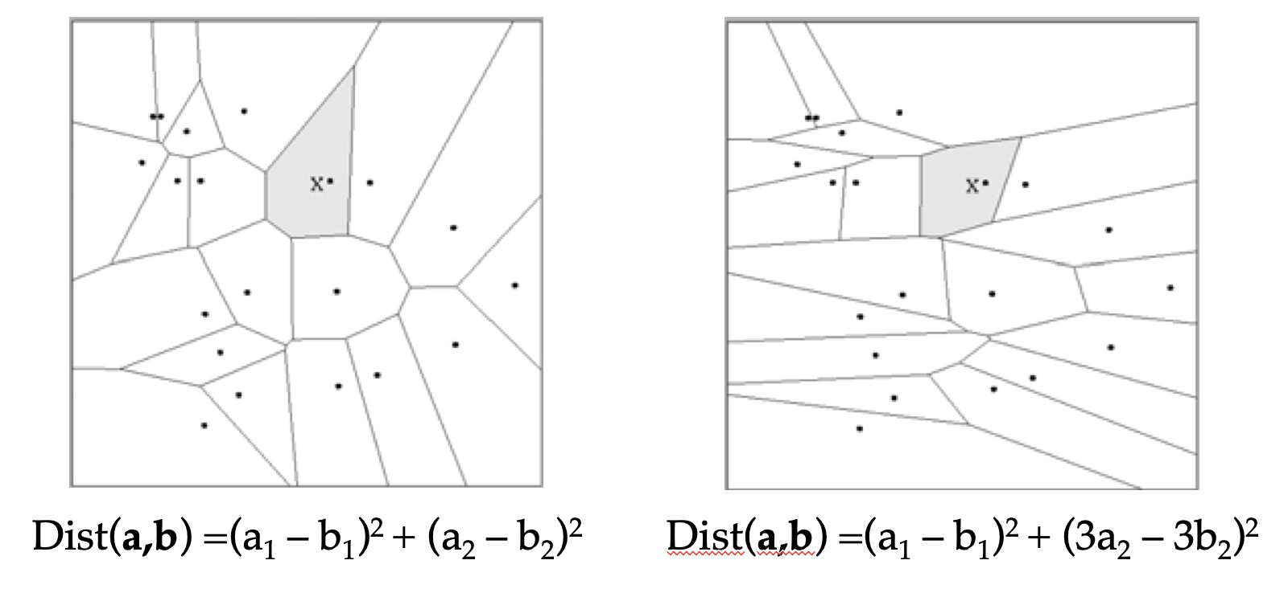
Distance Metrics
Different metrics can change the decision surface
Standard Euclidean distance metric:
Two-dimensional:
Dist(a,b) = sqrt((a₁ – b₁)² + (a₂ – b₂)²)
Multivariate:
Dist(a,b) = sqrt(∑ (a_{i} – b_{i})²)

Slide 30
1-NN Aspects As Instance-Based Learning
A distance metric
Euclidean
When different units are used for each dimension
→ normalize each dimension by standard deviation
For discrete data, can use hamming distance
→ D(x1,x2) =number of features on which x1 and x2 differ
Others (e.g., normal, cosine)
How many nearby neighbors to look at?
One
How to fit with the local points?
Just predict the same output as the nearest neighbor.

Slide 31
K-Nearest Neighbor
Generalizes 1-NN to smooth away noise in the labels
A new point is now assigned the most frequent label of its k nearest neighbors
Label it red, when k = 3
Label it blue, when k = 7

Slide 32
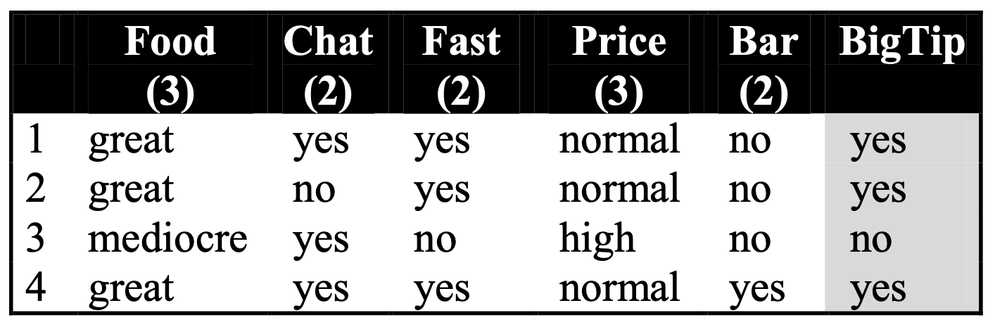
KNN Example
Similarity metric: Number of matching attributes (k=2)
New examples:
Example 1 (great, no, no, normal, no)
→ most similar: number 2 (1 mismatch, 4 match) → yes
→Second most similar example: number 1 (2 mismatch, 3 match) → yes
Example 2 (mediocre, yes, no, normal, no)
Most similar: number 3 (1 mismatch, 4 match) → no
→Second most similar example: number 1 (2 mismatch, 3 match) → yes

Slide 33
Selecting Number of Neighbor
Increase k:
Makes KNN less sensitive to noise
Decrease k:
Allows capturing finer structure of space
➔Pick k not too large, but not too small (depends on data)

Slide 34
Curse of Dimensionality
Prediction accuracy can quickly degrade when number of attributes grows.
Irrelevant attributes easily “swamp” information from relevant attributes
When many irrelevant attributes, similarity/distance measure becomes less reliable
Remedy
Try to remove irrelevant attributes in pre-processing step
Weight attributes differently
Increase k (but not too much)

Slide 35
Advantages and Disadvantages
Need distance/similarity measure and attributes that “match” target function.
For large training sets,
→ Must make a pass through the entire dataset for each classification. This can be prohibitive for large data sets.
Prediction accuracy can quickly degrade when number of attributes grows.
Simple to implement algorithm;
Requires little tuning;
Often performs quite well!
(Try it first on a new learning problem).

Slide 36
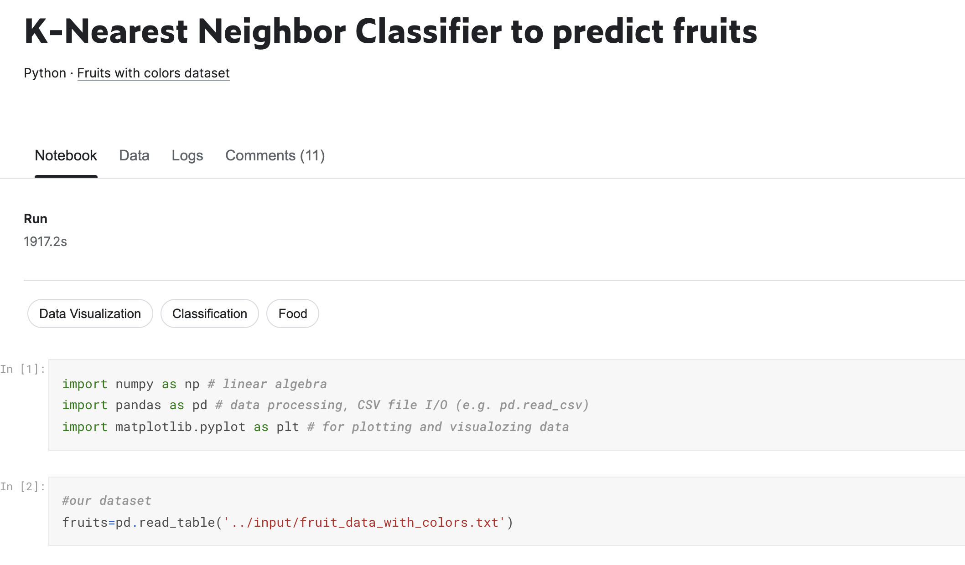
Home Work
StatQuest PCA: https://www.youtube.com/watch?v=_UVHneBUBW0
StatQuest KNN: https://www.youtube.com/watch?v=HVXime0nQeI
StarQuest Decision Tree: https://www.youtube.com/watch?v=_L39rN6gz7Y&t=61s

